Slide 1
DEPLOY PYTHON BASED WEB APPLICATION THROUGH MANUAL AND AUTOMATION

Slide 2
Vpc-virtual private cloud this is logically isolated from other networks it contains the subnets route tables, security groups and internet gateway.
Create a custamized vpc with the cidr range-192.168.0.0/24
Cidr(classless intern domain route)-it is same as the ip address but it ends with the slash after number the num indicates that how many addresses are allow.
Subnets-the vpc can be divided into smaller chunks easy to manage and s

Slide 3
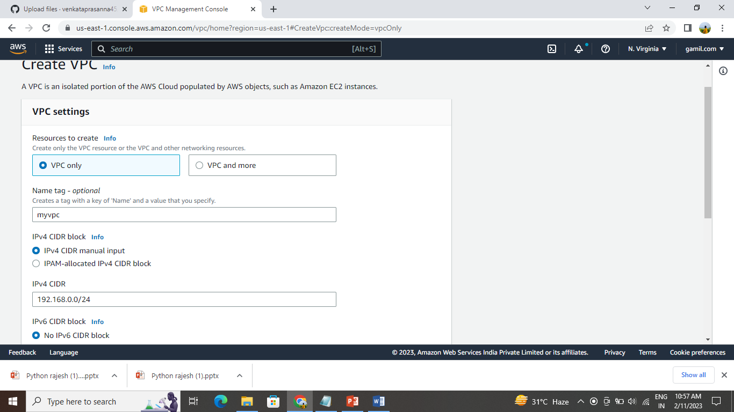
Create the vpc with cidr 192.168.0.0/16

Slide 4
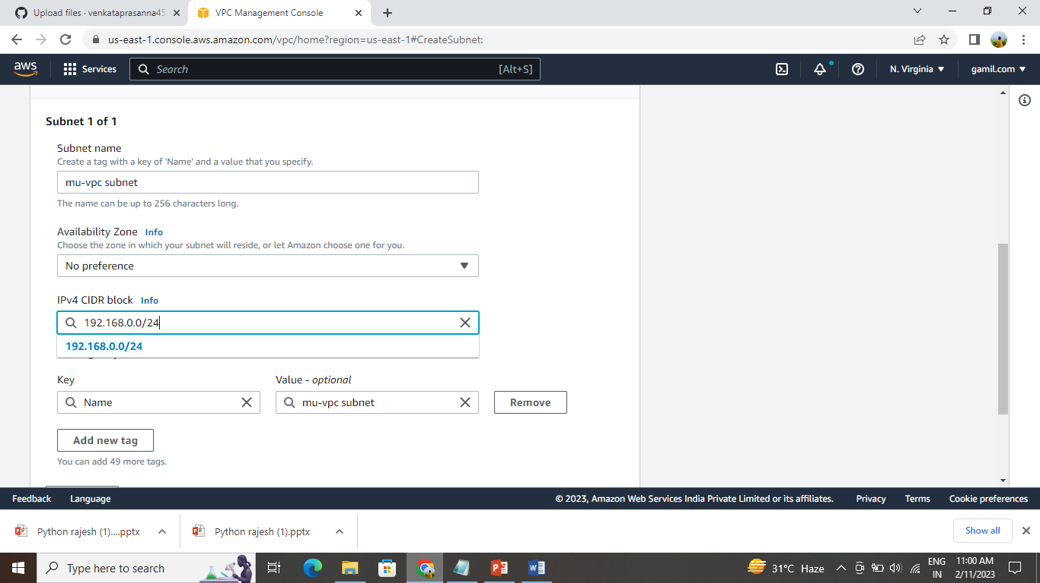
Create a subnet with cidr range is 192.168.0.0/24

Slide 5
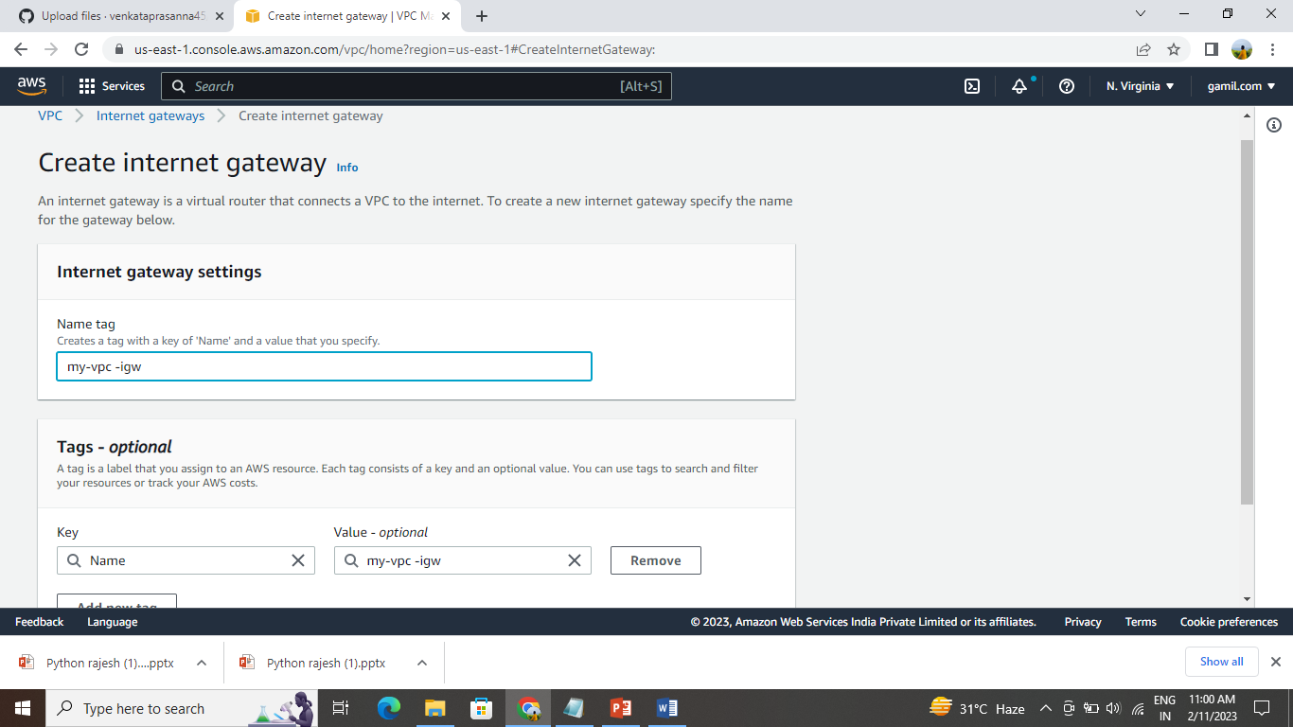
And after the create internet gateway and connect the internet gateway to the vpc

Slide 6
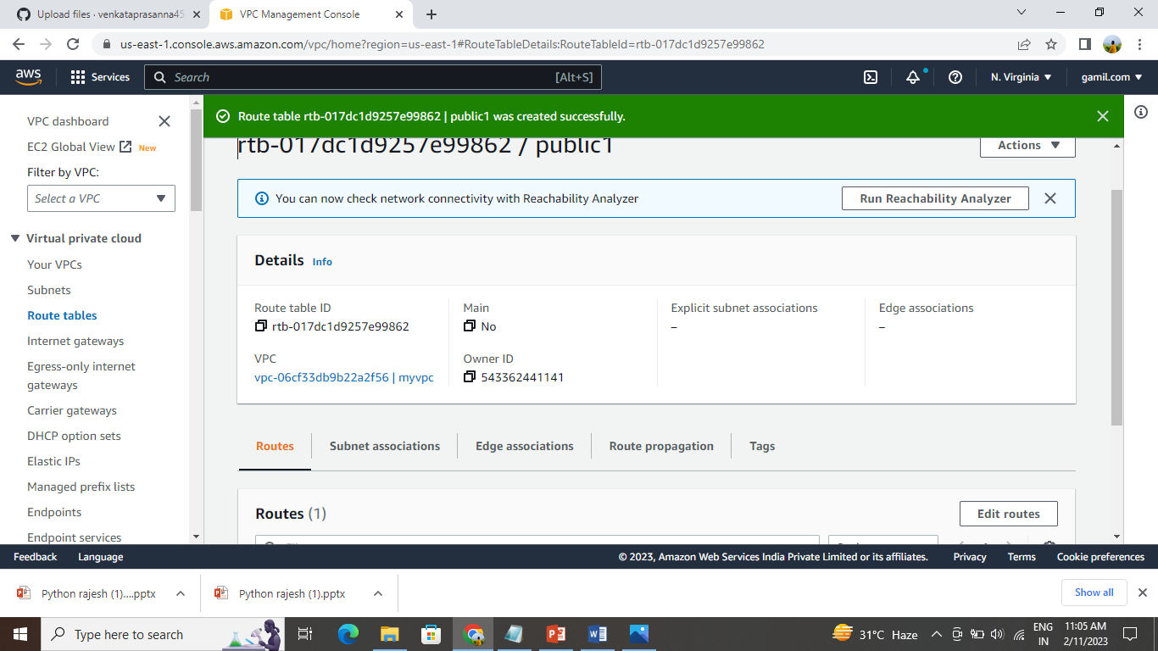
Create the route table and edit the route and subnet associations

Slide 7
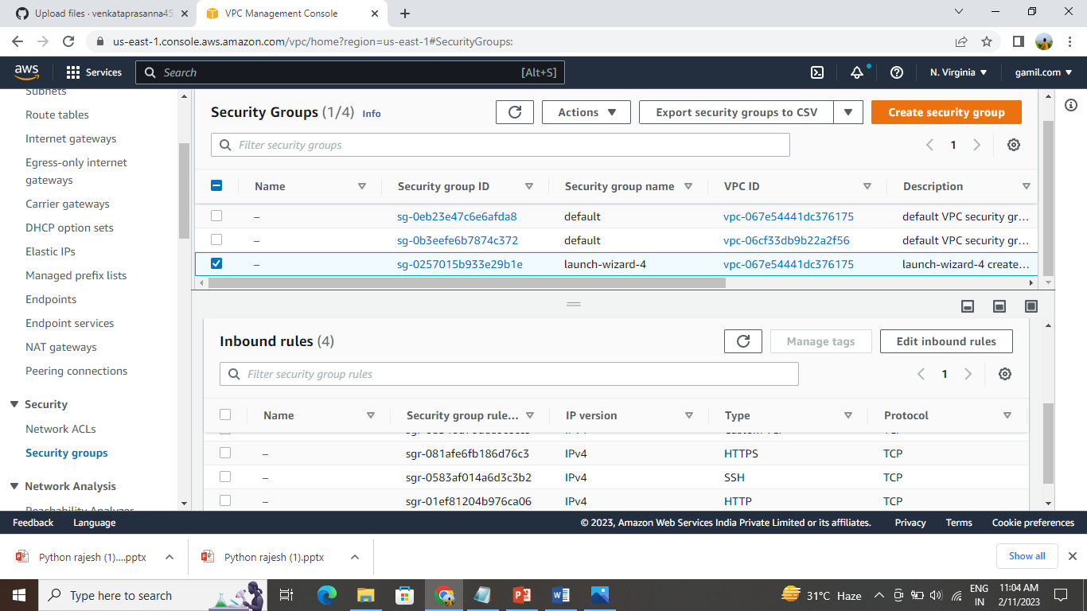
Create security groups

Slide 8
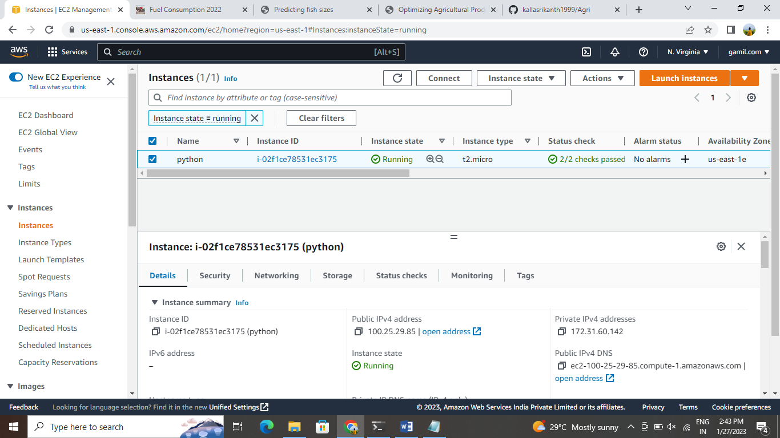
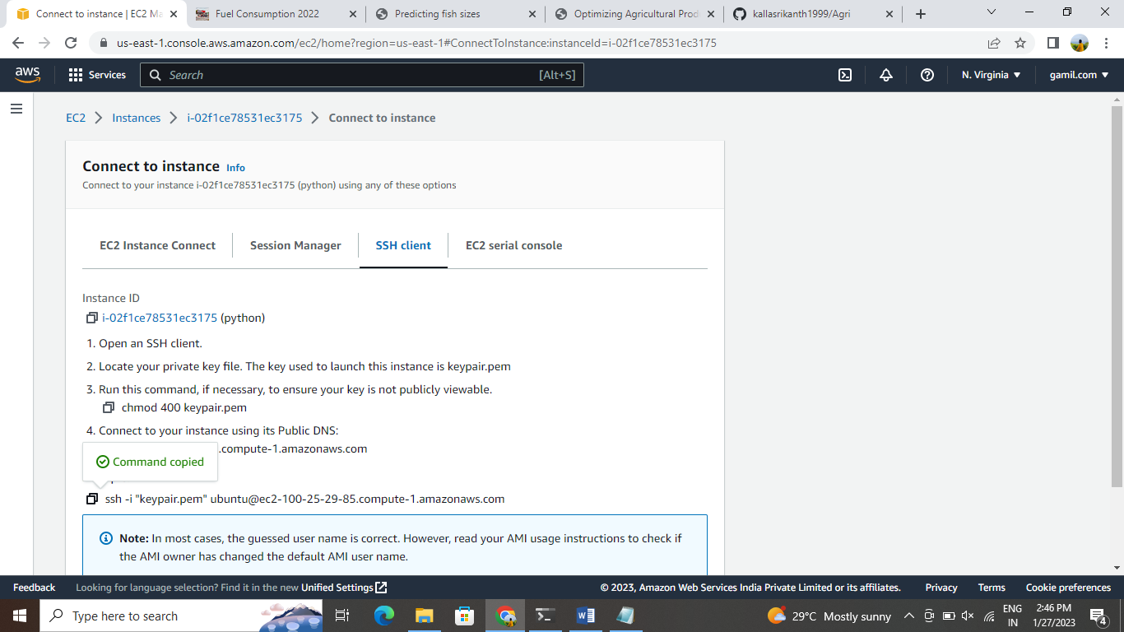
Ec2-elastic cloud compute virtual machine in the cloud on which you have os-level control you can run this cloud server whenever you want.

Slide 9
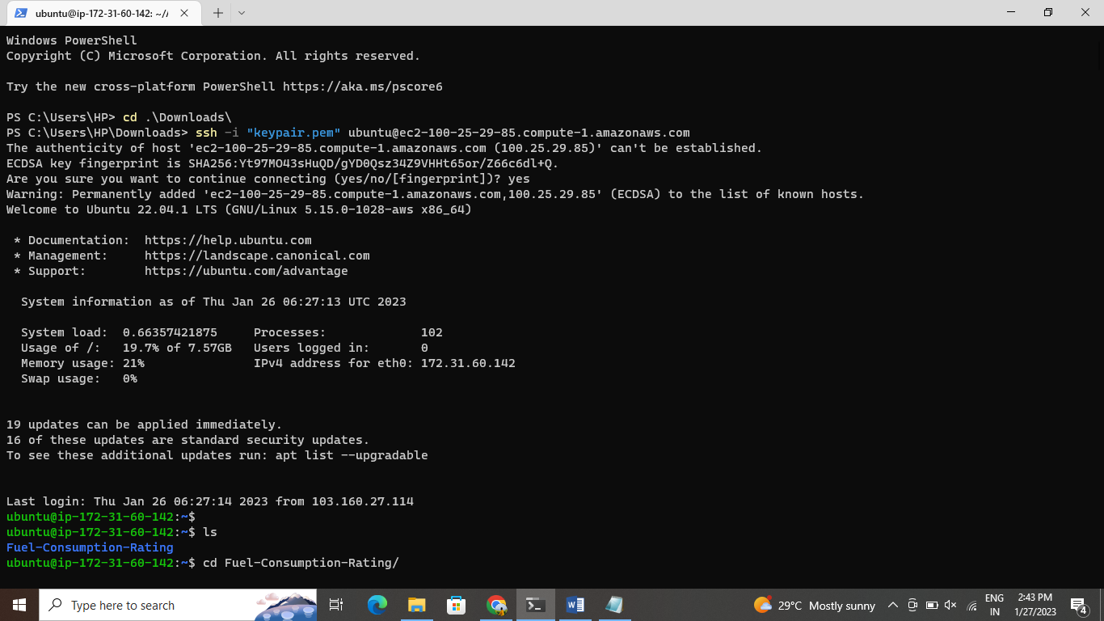
Connect the instance to the terminal

Slide 10
Update the ubuntu machine sudo apt update
Sudo apt-get full-upgrade –y
And install the required packages tools related for deploy the project
Sudo apt-get install python3-pip
And after the clone the code from the repository
Git clone https://github.com/amar-m-cloud/flask-library-app.git
Go to the source code directory cd flask-library

Slide 11
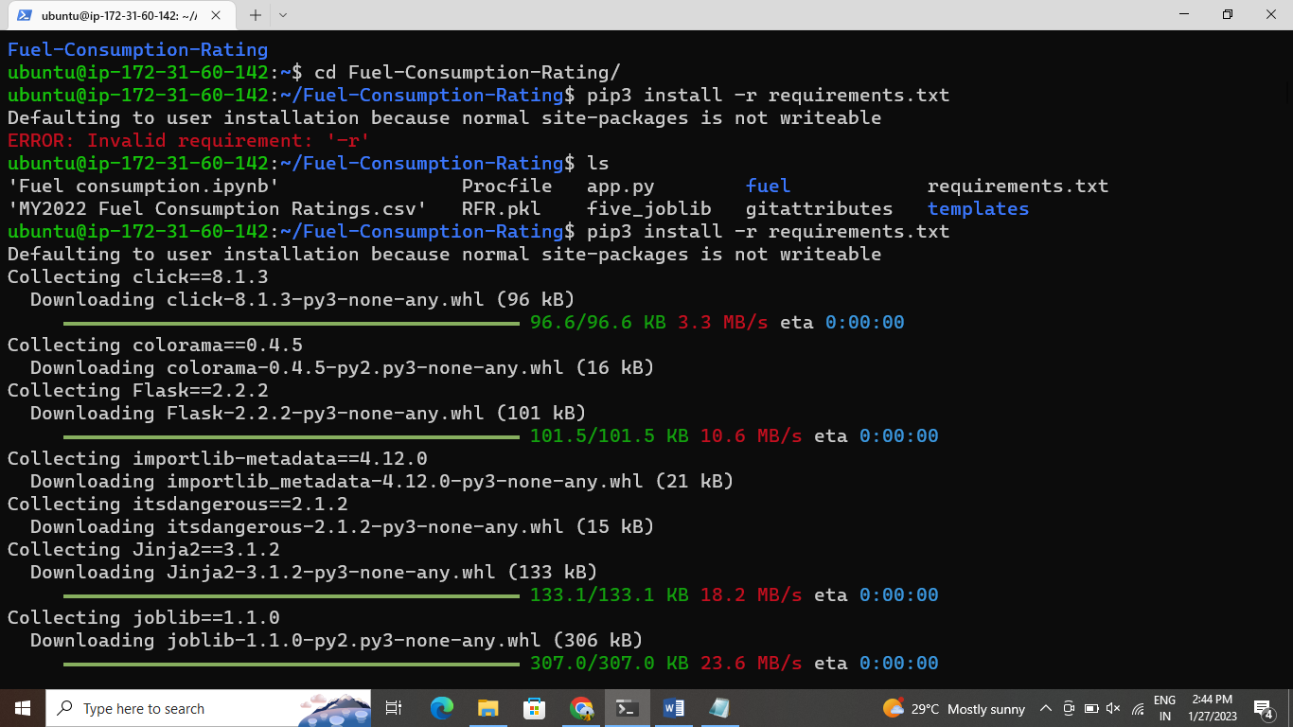
Install the requirements packages pip3 install –r requirements.txt

Slide 12
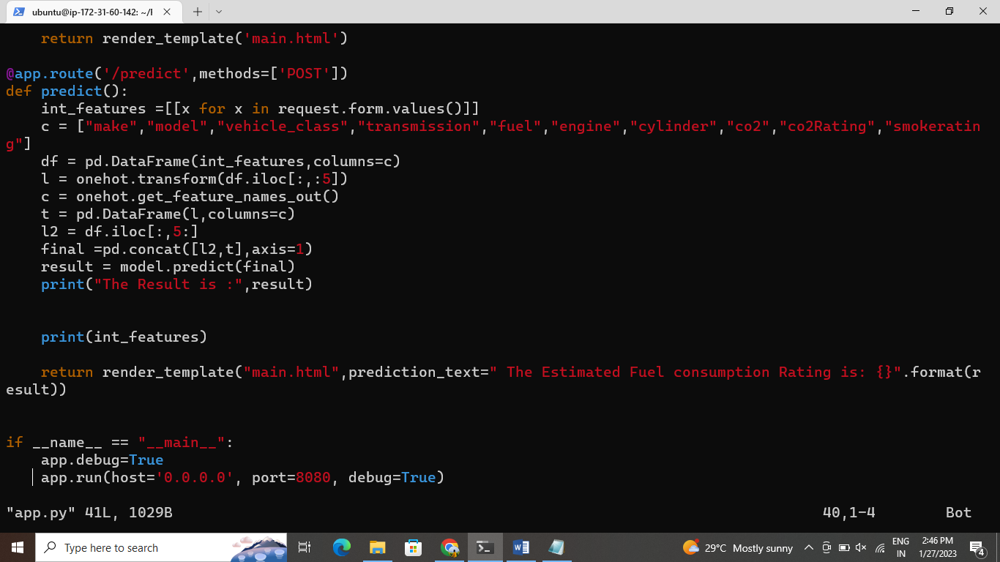
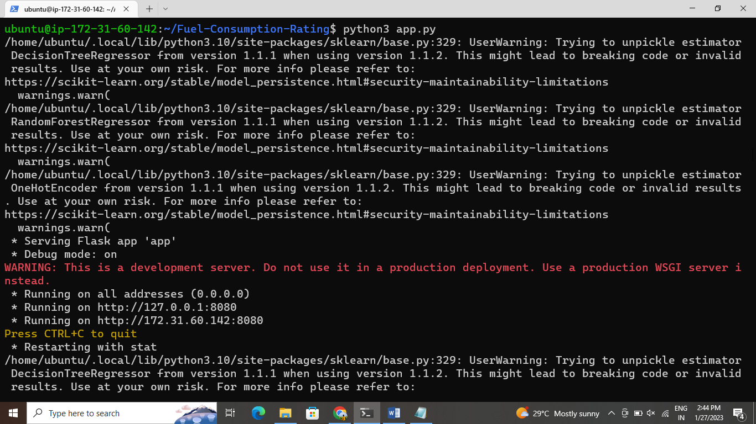
Run the flask server-python3 app.py edit the file app.py

Slide 13
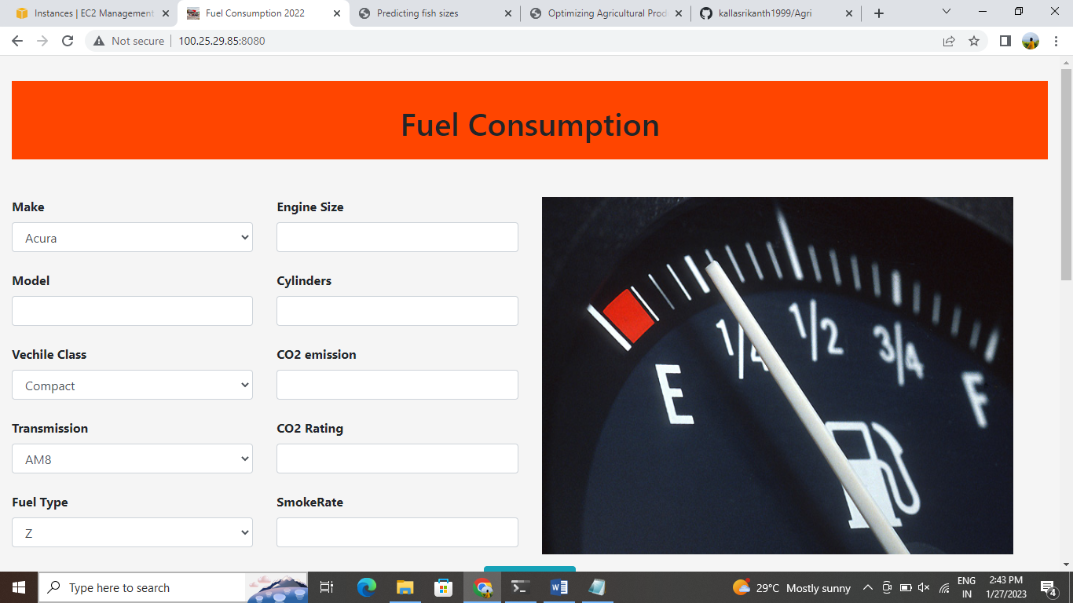
And again run the command python3 app.py and copy the public ip on the browser

